Slide 1

Siliguri Institute of Technology
Rock-Paper-Scissor
Group 8:
Bikki Prasad
Rohit Shrivastava
Chandni Kumari
Shuvam Mishra
Rishu Kumar
Priyanshu Choudhary

Slide 2
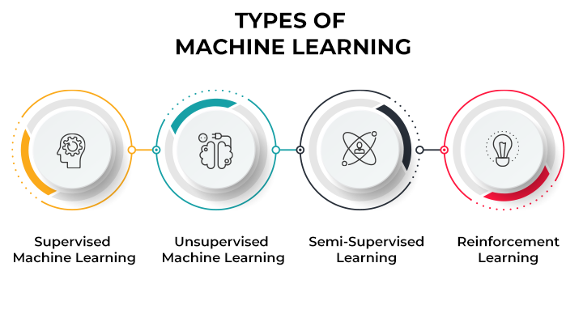
MACHINE LEARNING
Machine learning (ML) is a type of artificial intelligence (AI) that allows software applications to become more accurate at predicting outcomes without being explicitly programmed to do so. Machine learning algorithms use historical data as input to predict new output values.
Machine learning is important because it gives enterprises a view of trends in customer behavior and business operational patterns, as well as supports the development of new products. Many of today's leading companies, such as Facebook, Google and Uber, make machine learning a central part of their operations. Machine learning has become a significant competitive differentiator for many companies.

Slide 3
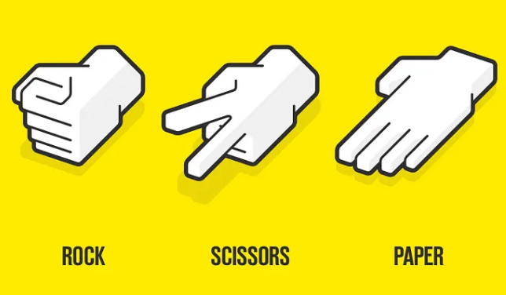
INTRODUCTION
What Is Rock Paper Scissors?
You may have played rock paper scissors before. Maybe you’ve used it to decide who pays for dinner or who gets first choice of players for a team.
If you’re unfamiliar, rock paper scissors is a hand game for two or more players. Participants say “rock, paper, scissors” and then simultaneously form their hands into the shape of a rock (a fist), a piece of paper (palm facing downward), or a pair of scissors (two fingers extended). The rules are straightforward:
Rock smashes scissors.
Paper covers rock.
Scissors cut paper.

Slide 4
PROBLEM STATEMENT
The basis of this project was to experiment with Machine Learning and Image Classification with the aim of building a simple yet fun iteration of the infamous Rock Paper Scissors game. This project is a product of boredom through the COVID19 Quarantine Period in May, thankfully, by the time we’re reading this, things are back to normal. Through the course of this explanation, our aim is to explain the fundamentals of this project in simple terms aimed towards beginners.
Project Structure:
Step 1: Gather Data, for rock, paper scissor classes.
Step 2: (Optional) Visualize the Data.
Step 3: Preprocess Data and Split it.
Step 4: Prepare Our Model for Transfer Learning.
Step 5: Train Our Model.
Step 6: Check our Accuracy, Loss graphs & save the model.
Step 7: Test on Live Webcam Feed.
Step 8: Create the Final Application.

Slide 5
CHALLENGES
The challenge of the game is to guess what your opponent will choose and pick the appropriate object to beat them.
People find it quite hard to pick a sequence of perfectly random choices, so any pattern that a player develops could be learned by the opponent and used to win the game. That is what happens in this example. As you play, the computer learns the pattern of objects that you are most likely to pick.

Slide 6
SOLUTION APPROACH
How Does it Work?
The computer keeps track of the conditional probabilities of you picking each of the three objects given the object you picked last. The computer always picks the object that beats the one that it thinks you are most likely to choose. Although it knows what you have actually picked (you press one of the buttons to make your choice), it is honest and doesn't cheat!
You can observe the computer learning by picking a strategy and sticking to it for a while. Here are a few things to try:
Pick Rock, then Paper, then Scissors, then Rock again and keep that pattern up. See how quickly the computer learns to beat you every time?
Having done that a few times, change strategy and pick Paper 5 times in a row. See how the computer spots your change of strategy and alters its play?
Pick any strategy of your own and see if the computer can spot the pattern.
See if you can be perfectly random in your choices and beat the computer.

Slide 7
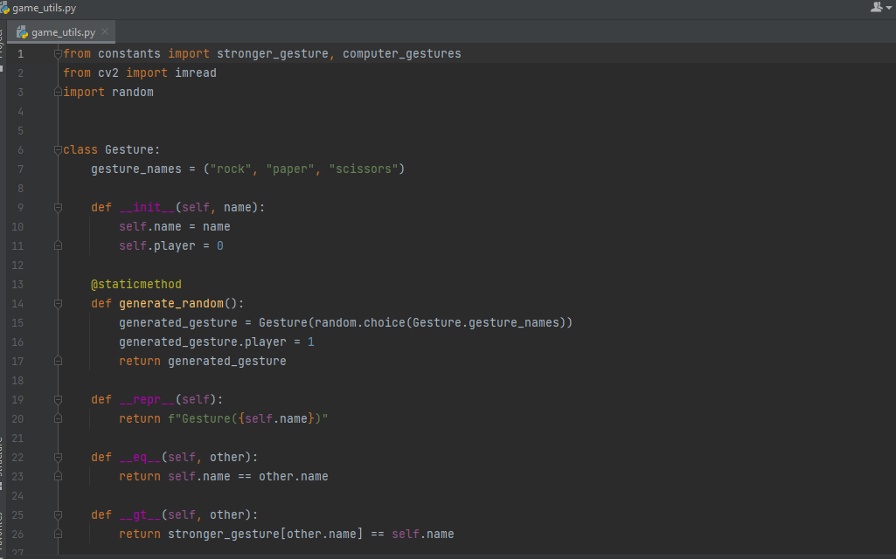






Collecting Data
Any Machine Learning Engineer would agree that in ML the data is far more crucial than the algorithm itself. We need to collect images for the symbols Rock, Paper and Scissor

Slide 8
LIBRARIES USED
TensorFlow is a free and open-source software library for machine learning and artificial intelligence. It can be used across a range of tasks but has a particular focus on training and inference of deep neural networks.
NumPy is a Python library used for working with arrays.It also has functions for working in domain of linear algebra, fourier transform, and matrices.NumPy was created in 2005 by Travis Oliphant. It is an open source project and you can use it freely.NumPy stands for Numerical Python.
OpenCV is a library of programming functions mainly for real-time computer vision. Originally developed by Intel, it was later supported by Willow Garage, then Itseez. The library is cross-platform and licensed as free and open-source software under Apache License

Slide 9
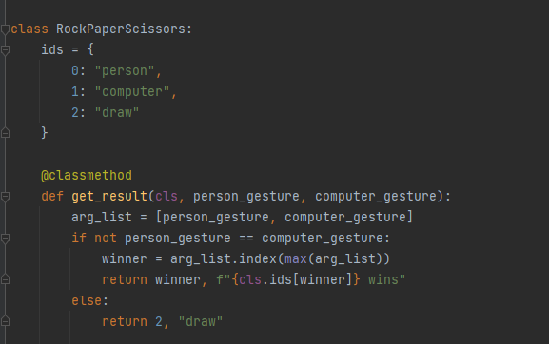
PreProcessing our Data:
We do some manual Data Augmentation by flipping the image and zooming into it. This increases our dataset size without having the need to take new photos. Data Augmentation is a crucial part to generating datasets. Finally the images and labels are stored in separate numpy arrays.

Slide 10
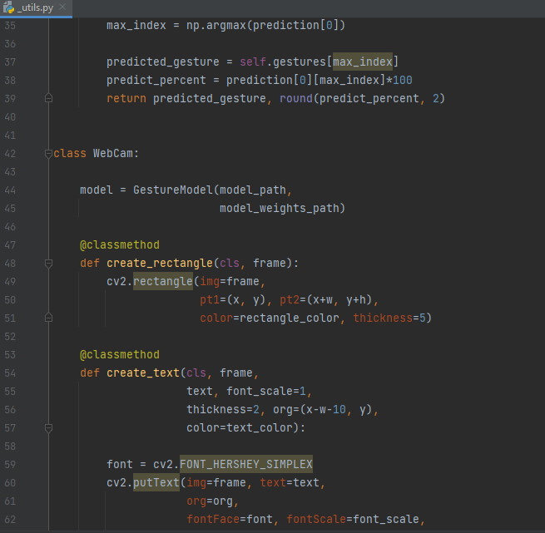
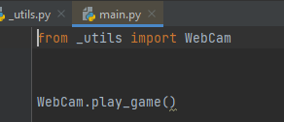
OpenCV implementation: The flow for this implementation is simple: Start webcam feed and read each frame Pass this frame to model for classification ie. predict class Make a random move by computer Calculate Score

Slide 11
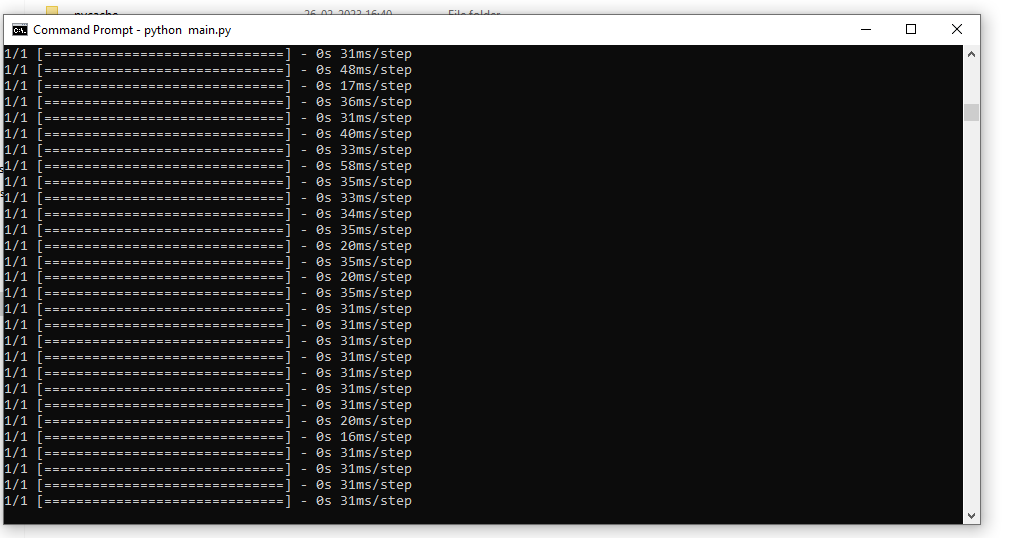
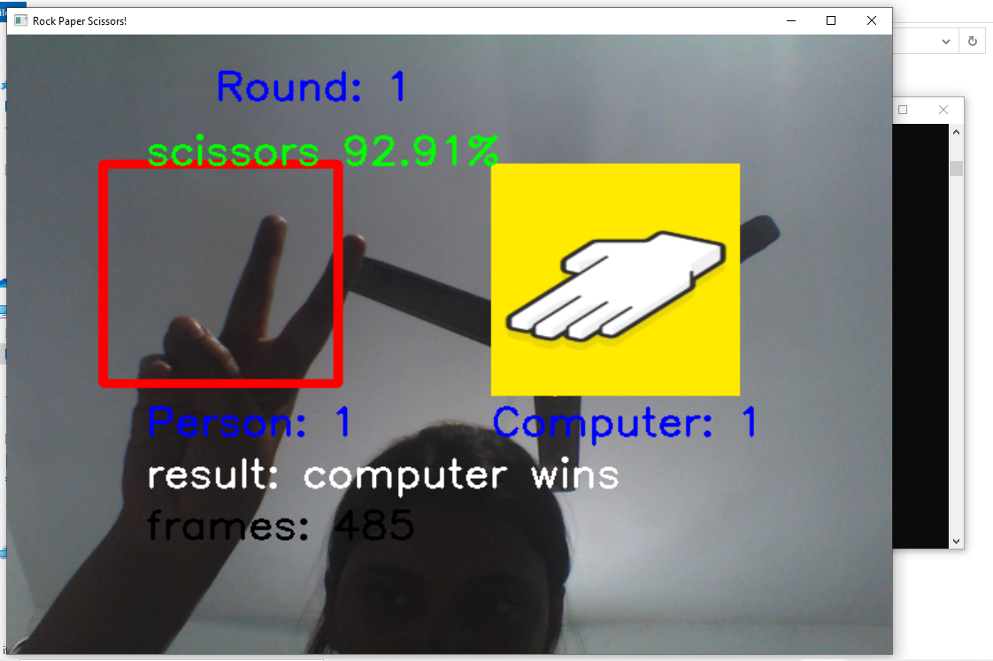
USER INTERFACE

Slide 12
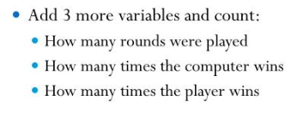
Conclusion:
Congratulations! we just finished our first Rock-Paper-Scissor game! we now know how to create rock paper scissors from scratch, and we’re able to expand the number of possible actions in our game with minimal effort.
THANK YOU

